Slide 1
RAN Meeting
October 2016

Slide 2
Revised Fringe Rate memo as of October 2016
Increases Main Campus RA/ PA Health Insurance
Health Insurance no longer the same for Main and HSC fringe memos
New memo posted on OSP website (as of 10/3/16)
Budget Template updated soon with new rates
Federal Continuing Resolution until 12/9/2016
Federal spending cannot exceed previous fiscal year
NIH NOT-OD-16-046 indicates non-competing research grant awards will be issued“ …at a level below that indicated on the most recent Notice of Award (generally 90% of the previously committed level.”
See http://grants.nih.gov/grants/guide/notice-files/NOT-OD-17-001.html
Just announced last Friday; OSP has not seen reduced funding notices yet from NIH
PI / Departmental Authorizer / Organizational Hierarchy changes
Please request changes as they occur (arrivals or departures)
Org Hierarchy changes completed with FSM prior to Cayuse

Slide 3
Proposal due date for a Subaward In
Due date in Cayuse is the date OSP submits to the Sponsor
Other OSP offices also have 5 day requirements to consider in planning due dates
Facilitates coordination to have the Sponsor’s PI and their OSP information in the Notes
Federal Demonstration Partnership (FDP) updates
Cost reimbursable and Fixed Price templates
Forms for foreign subawardees
See http://sites.nationalacademies.org/PGA/fdp/PGA_063626
Winter Break Schedule
Dec. 15 last day to submit for proposals due Jan 4, 2017
Dec. 20 last day to submit for proposals due Jan 5, 2017 or later

Slide 4
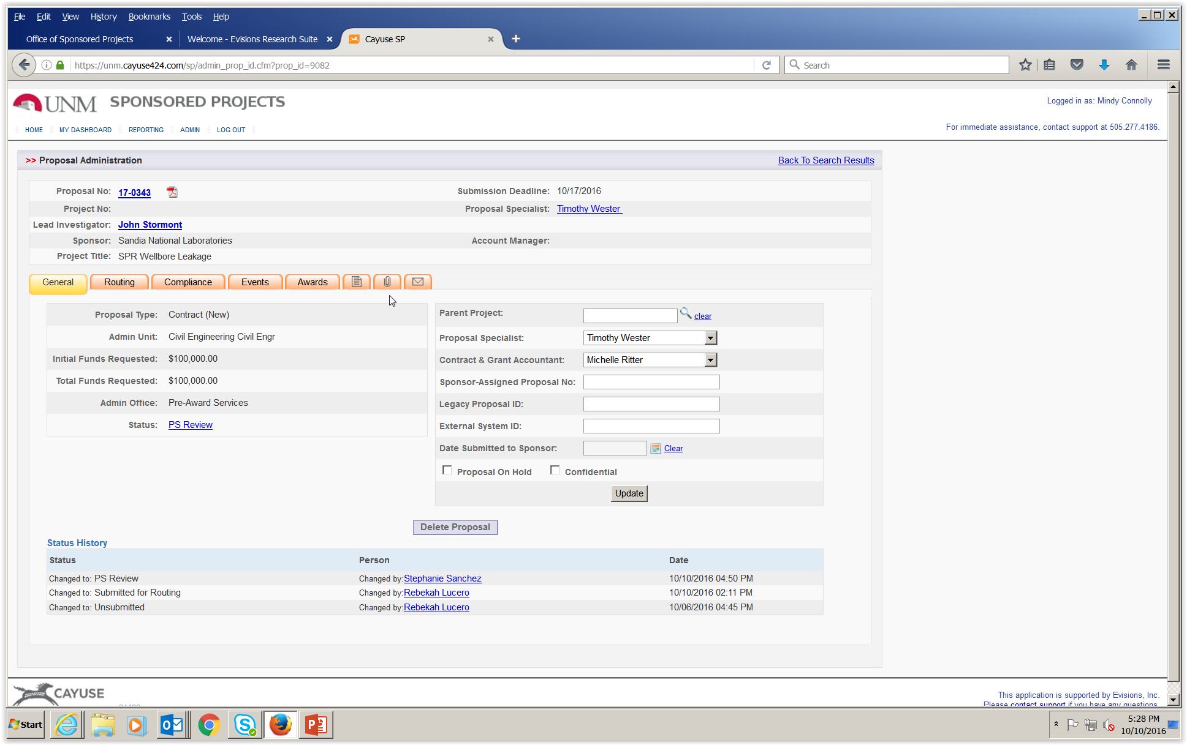
Activity Code Updates in Cayuse

Slide 5
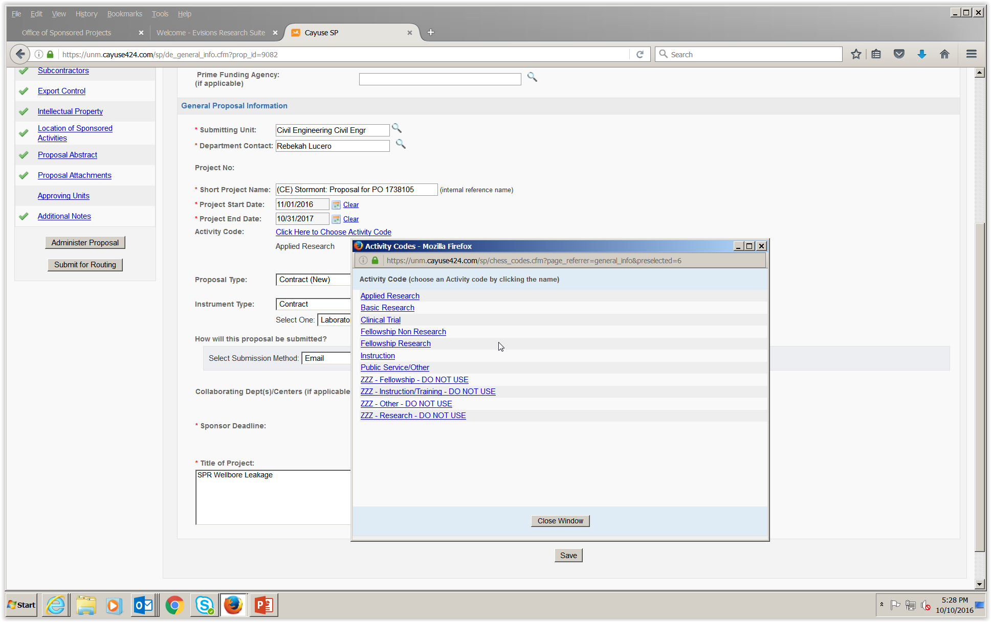
Scroll down to Activity Code
“Click Here to Choose Activity Code”

Slide 6
Activity Code options (Must choose one!)
- Applied Research : solves a problem
Basic Research: theory or testing hypotheses
Clinical Trial
Fellowship Non Research
Fellowship Research
Instruction: Sponsored for college credit courses
Public Service/ Other: Most likely an Other Sponsored Project
How to determine Activity Code:
Ask the PI; the preferred method!
Use the CFDA (See CFDA.gov); describes the funded activity
Read the Statement of Work
Coordinate with OSP staff
Important for federal reporting, audits, and to UNM financial statements

